Slide 1

Retail Sales Analytics Dashboard
2320030278 – Cherukuri Sai Deekshitha
2320030355 – Paladi Raga Amrutha Ratna
2320030104 – Ravuri Bramhani
Sec-4

Slide 2
📌 1. Introduction
Retail businesses generate huge amounts of data daily through sales transactions, customer purchases, and inventory systems. Managing and analyzing this data using traditional systems is difficult due to scalability issues, lack of integration, and delayed insights.
With the advancement of cloud computing, modern solutions like Microsoft Azure provide scalable and efficient platforms for storing and processing large datasets. This project focuses on building a Retail Sales Analytics Dashboard that helps businesses analyze their sales data effectively and make data-driven decisions using cloud technologies and visualization tools.

Slide 3
📌 2. Abstract
Retail businesses generate large volumes of sales data on a daily basis through transactions, products, and customer interactions. However, traditional systems often face challenges in handling large datasets, providing scalability, and delivering timely insights. This creates the need for a modern cloud-based solution that can efficiently store, process, and analyze retail data for better decision-making.
This project presents a Retail Sales Analytics Dashboard using Microsoft Azure and Power BI. In this system, sales data is stored in Azure Blob Storage, which provides scalable and cost-effective storage for raw data. Azure Data Factory is used to automate the data ingestion process, transferring data into Azure Synapse Analytics, where it is processed and organized. Finally, Power BI is used to create interactive dashboards that visualize key insights such as sales trends and product performance.

Slide 4
📌 3. Objectives
To design a scalable cloud-based data analytics system
To automate data ingestion using Azure Data Factory
To store large datasets efficiently using Azure Blob Storage
To process and analyze data using Azure Synapse Analytics
To create interactive dashboards using Power BI
To provide real-time insights for business decision-making

Slide 5
📌 4. Literature Survey
Traditional retail data analysis methods rely on tools like Excel and local databases, which have limitations in handling large datasets and real-time analytics. On-premise data warehouses offer structured storage but involve high costs and complex maintenance.
Recent studies show that cloud platforms like Microsoft Azure provide scalable, flexible, and cost-effective solutions for big data analytics. Tools like Azure Data Factory, Azure Data Lake, and Power BI enable automated pipelines, efficient data processing, and interactive visualization. These technologies improve decision-making and reduce infrastructure complexity.

Slide 6
📌 5. Proposed Solution
The proposed system is a cloud-based retail analytics platform built using Microsoft Azure services. It integrates:
Azure Blob Storage for data storage
Azure Data Factory for data ingestion
Azure Synapse Analytics for processing
Power BI for visualization
This system provides an end-to-end pipeline from data collection to insight generation, ensuring scalability, automation, and real-time analytics.

Slide 7
📌 6. Methodology
The project follows these steps:
Data collection from retail sources
Data storage in Azure Blob Storage
Data ingestion using Azure Data Factory
Data processing and transformation in Azure Synapse
Data visualization using Power BI dashboards
Deployment and automation of pipelines
This methodology ensures efficient data flow and analysis.

Slide 8
📌 7. Expected Results
Efficient handling of large retail datasets
Automated data processing pipeline
Real-time visualization of sales data
Improved decision-making through insights
Reduced operational cost using cloud solutions

Slide 9
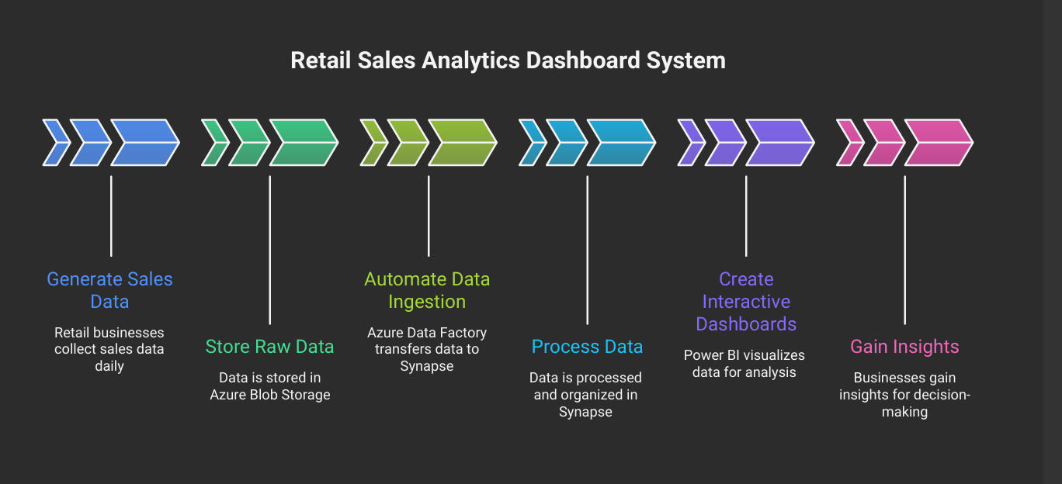
📌 8. Implementation

Slide 10
📌 9. Results
The system successfully:
Processes large-scale retail data efficiently
Provides interactive dashboards for analysis
Displays sales trends, regional performance, and product insights
Enables quick and data-driven decision-making
The final dashboard improves visibility and helps businesses optimize their strategies.

Slide 11
